Slide 1

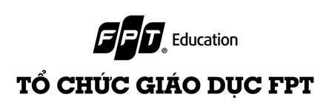
EXE101 - EXPERIMENTIAL ENTREPRENEURSHIP
Business Models
Slides by MBA Ha Phan, FPT University HCMC

Slide 2

Learning Objectives
Understand Business Model Fundamentals Gain a comprehensive understanding of the key components of business models, including value proposition, customer segments, revenue streams, cost structure, and key resources.
Evaluate Business Model Strategies Develop the ability to critically evaluate different business model strategies, assessing their strengths, weaknesses, and strategic implications in diverse market contexts.
Apply Business Model Concepts Demonstrate proficiency in applying business model concepts to analyze real-world business scenarios, innovate solutions, and adapt strategies to changing market dynamics.

Slide 3

BUSINESS MODEL
A business model for a startup is a structured plan that defines the value proposition, target customer segments, revenue streams, cost structure, and key activities required to deliver the product or service. It encompasses the strategy for generating revenue and sustaining the business over time. (Epstein, 2022)

Slide 4

BUSINESS MODEL (cont.)
A business model is a strategic framework for creating and delivering value to customers while capturing value in return. It describes the rationale of how an organization creates, delivers, and captures value, in economic, social, cultural, or other contexts (Magretta, 2002).
According to Amit and Zott (2001), a business model is a depiction of the content, structure, and governance of transactions designed to create value through the exploitation of business opportunities.
A unique business model can provide a competitive edge by differentiating the startup from other players in the market. It highlights the startup’s unique value proposition and how it addresses customer needs more effectively than competitors (Amit and Zott, 2001)

Slide 5

Importance of a Business Model for a Startup
Guides Strategic Planning
Attracts Investors
Helps Identify Key Metrics
Differentiates from Competitors
Facilitates Market Validation
Ensures Financial Viability
Supports Scaling
(Epstein, 2022)

Slide 6
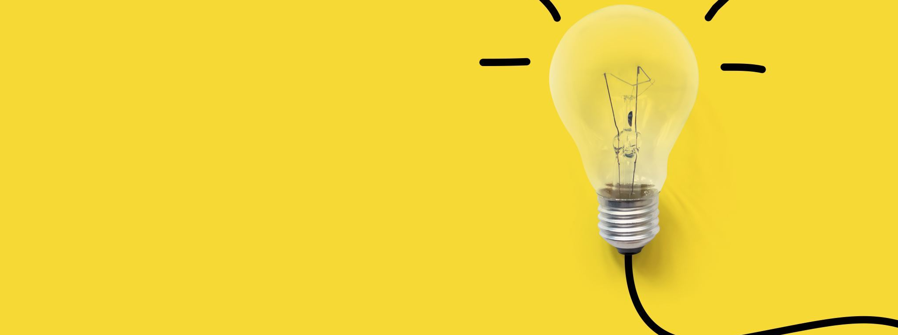
BUSINESS MODEL (cont.)
--> The business model is the vehicle through which a company generates revenue and creates value for its customers. It encompasses the strategy for delivering a product or service, the target market, and the sources of revenue. A successful business model is essential for long-term sustainability and growth.

Slide 7

ENTERPRISE
An enterprise company sells high-value products or services to large organizations. (Epstein, 2022)
These contracts have fixed terms and designated contract values, and come up for renewal at the end of the term.
Advantages
High Revenue Per Customer Large contracts with significant revenue.
Long-Term Relationships Often involves long-term contracts.
Challenges
Long Sales Cycles Selling to enterprises can take a long time.
Complex Sales Process Requires tailored solutions and dedicated sales teams.

Slide 8
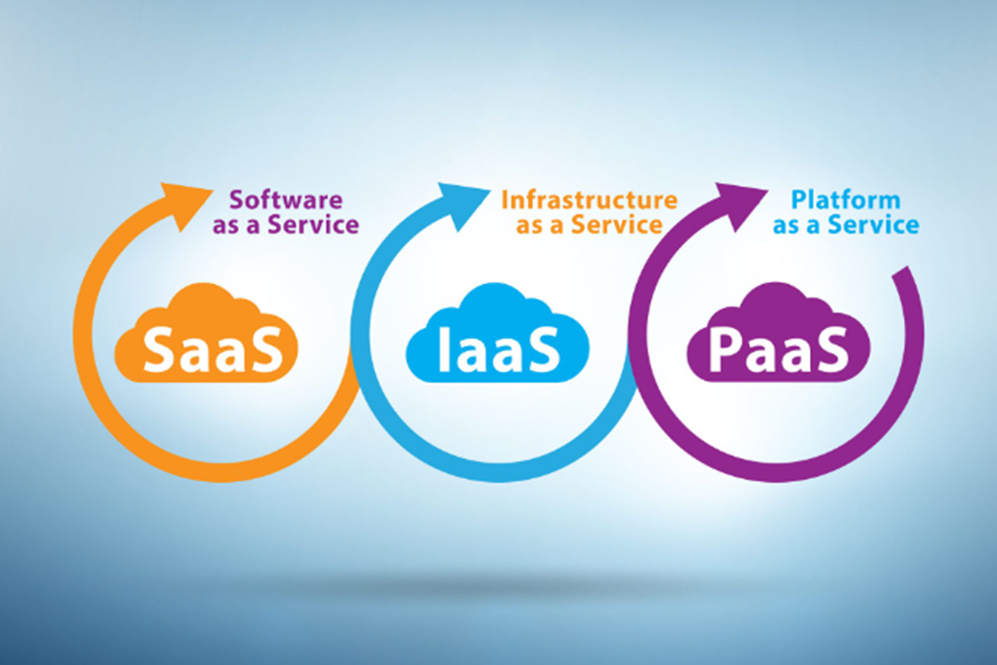
2. SaaS _ IaaS _ PaaS
A SaaS (software-as-a-service) company sells subscription-based licenses for a cloud-hosted software solution
The evolution from SaaS to IaaS and PaaS represents different layers of cloud computing services that cater to varying degrees of IT infrastructure management and service delivery.
(Epstein, 2022)

Slide 9

2. SaaS _ IaaS _ PaaS (cont.)
IaaS (Infrastructure-as-a-Service) delivers virtualized computing resources over the internet. It provides virtualized computing infrastructure, including virtual machines, storage, and networking resources, on a pay-as-you-go basis.
Ex Amazon Web Services (AWS) EC2, Microsoft Azure Virtual Machines, Google Compute Engine.

Slide 10

2. SaaS _ IaaS _ PaaS (cont.)
PaaS (Platform-as-a-Service) provides a platform allowing customers to develop, run, and manage applications without the complexity of building and maintaining the underlying infrastructure.
Ex Microsoft Azure App Service, Google App Engine, Heroku.

Slide 11

3. USAGE-BASE
Usage-based pricing, also known as consumption-based pricing, customers pay based on how much they use the service. (Epstein, 2022)
Unlike traditional fixed pricing models, where customers pay a set fee regardless of usage, usage-based pricing aligns costs more closely with value received.
Usage-based pricing to attract customers who may be hesitant to commit to fixed fees upfront. This model allows startups to scale their revenue alongside customer usage.

Slide 12

4. SUBSCRIPTION
A subscription sells a product or a service, usually to a consumer, on a recurring basis. (Epstein, 2022)
Tiered pricing, personalized content recommendations
Ex Netflix

Slide 13

5. TRANSACTIONAL
A transactional company enables a financial transaction on behalf of a customer and collects a fee (usually a percent of the underlying transaction).
Facilitate transactions and take a cut of those transactions. (Epstein, 2022)
The transactional business model revolves around customers paying for goods or services on a per-transaction basis, rather than through recurring subscriptions or long-term commitments.

Slide 14
6. MARKETPLACE
A marketplace company acts as an intermediary in the sale of a good or service between sellers and buyers, generally collecting a percent of the total transaction value;
Facilitate transactions between buyers and sellers, often referred to as two-sided marketplaces.(Epstein, 2022)
Definition and Characteristics
Two-Sided Platform
Marketplace connects two distinct customer groups buyers and sellers/service providers.
Facilitates transactions, exchanges, or interactions between these groups.
Transaction Facilitation
Provides a platform for transactions, where buyers can discover products/services and sellers can reach a broader audience.
Network Effects
Benefits from network effects as more buyers attract more sellers, and vice versa, creating a self-reinforcing cycle of growth.
Increasing platform usage enhances value for all participants.

Slide 15
6. MARKETPLACE (cont.)
Advantages
Network Effects Value increases as more users join the platform.
Winner-Takes-All Often dominate their market once a critical mass is reached.
Challenges
Chicken and Egg Problem Need to balance acquiring both buyers and sellers.
(Epstein, 2022)

Slide 16
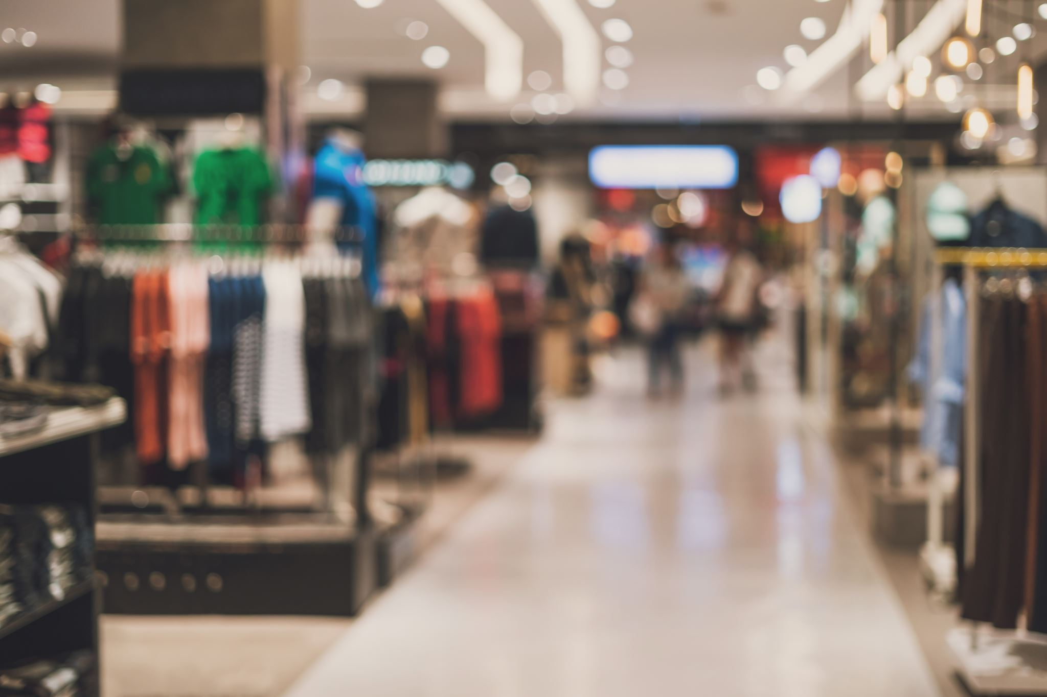
7. E-COMMERCE
E-commerce (electronic commerce) refers to the buying and selling of goods or services over the internet or other electronic networks; Selling products or services online (Epstein, 2022)
It involves conducting business transactions electronically, typically through online platforms such as websites, mobile apps, or online marketplaces.
E-commerce transactions may include the purchase of physical products, digital goods (e-books, software), services (online courses, consulting), and more.

Slide 17
7. E-COMMERCE (cont.)
Advantages
Direct to Consumer Eliminates intermediaries, potentially increasing margins.
Scalability Can reach a global market with relatively low overhead.
Challenges
Logistics and Fulfillment Managing inventory and shipping.
Competition Highly competitive with often thin margins.
(Epstein, 2022)

Slide 18
7. E-COMMERCE (cont.)
E-commerce encompasses various business models, including
Business-to-Consumer (B2C),
Business-to-Business (B2B),
Consumer-to-Consumer (C2C
Other specialized models such as Dropshipping or Subscription-based commerce...

Slide 19
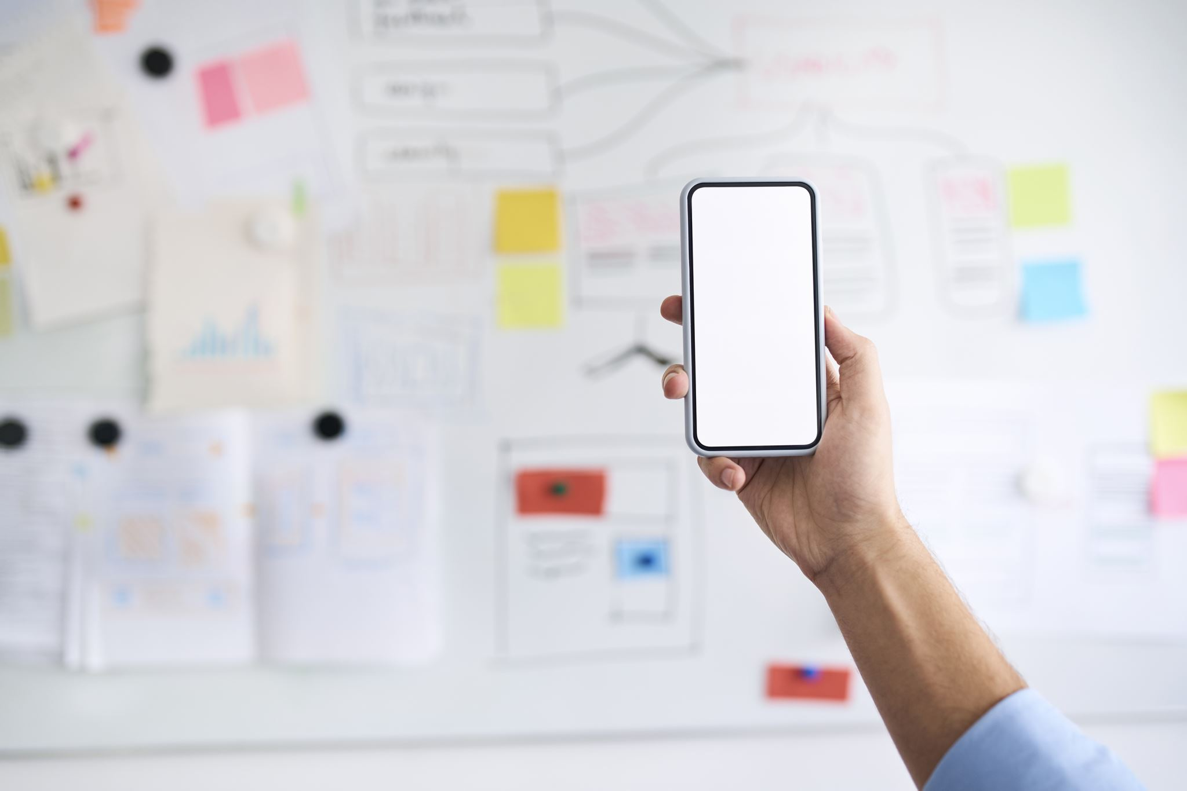
8. ADVERTISING
Revenue generated through selling advertising space or promoting products or services;
Revenue generated primarily through ads. (Epstein, 2022)
Revenue from Advertisers Generates revenue by displaying advertisements to users.
Monetization Methods Typically uses pay-per-click (PPC), cost-per-impression (CPM), or other performance-based pricing models.
Targeted Advertising Emphasizes the importance of targeted ads based on user demographics, behavior, and interests.
User Engagement Advises startups to focus on creating engaging ad formats to maximize click-through rates (CTR) and conversions.

Slide 20
8. ADVERTISING (cont.)
Advantages
Scalable Revenue Revenue grows with user base and engagement.
Network Effects More users attract more advertisers.
Challenges
Need for Large User Base Requires a significant number of users to be profitable.
Dependence on User Engagement Revenue tied to how much users interact with ads.

Slide 21

9. HARD TECH
Hard Tech businesses are focused on significant technological innovations, often involving advanced research and development and the creation of physical products (Epstein, 2022)
Involves designing, prototyping, and manufacturing physical hardware products.
Requires R&D, production facilities, quality control, and potentially intellectual property (IP) development.
Developing cutting-edge hardware technologies involves inherent risks related to performance, reliability, and compatibility.
Startups must navigate technological uncertainties and potential setbacks during R&D phases.

Slide 22
9. HARD TECH (cont.)
Advantages
High Barriers to Entry Significant R&D investment and complex technological requirements deter competitors.
Intellectual Property Often protected by patents and other forms of IP, providing a competitive edge.
Innovation Leadership Pioneering new technologies can lead to industry leadership and long-term market dominance.
Challenges
Capital Intensive Requires substantial upfront investment to develop technology and bring products to market.
Long Development Cycles Products can take years to develop, test, and commercialize.
Regulatory Hurdles Must comply with industry regulations and standards, which can slow down progress.

Slide 23
10. FREEMIUM
The Freemium business model is a pricing strategy where a company offers basic services or products for free while charging a premium for advanced or additional features.
The term "freemium" is a combination of "free" and "premium."
This model is widely used in the digital economy, particularly by software and online service providers, to attract a large user base and convert a portion of them into paying customers (Pujol, 2010)

Slide 24
10. FREEMIUM (cont.)
Free Version
Basic features or services are offered to users at no cost.
Aimed at attracting a large user base and fostering initial engagement.
Premium Version
Enhanced features, functionality, or additional services are available for a subscription fee or one-time payment.
Designed to cater to users who require more advanced capabilities or specialized features.

Slide 25
11. PEER – TO - PEER (P2P)
The Peer-to-Peer (P2P) business model is a decentralized platform where two individuals interact directly with each other to buy, sell, or share goods and services. P2P platforms facilitate transactions by providing a trusted environment, often with features such as user reviews and secure payment systems. This model eliminates the need for intermediaries, allowing users to transact directly with one another (Botsman and Rogers, 2010)
Direct Interaction
Facilitates transactions or exchanges between peers without the need for intermediaries like traditional businesses or centralized platforms.
Examples include sharing economy platforms, online marketplaces, and collaborative consumption services.
Platform Facilitation
P2P platforms provide the infrastructure and tools for peers to connect, transact, and communicate securely.
Platforms often earn revenue through transaction fees, subscriptions, or advertising.

Slide 26
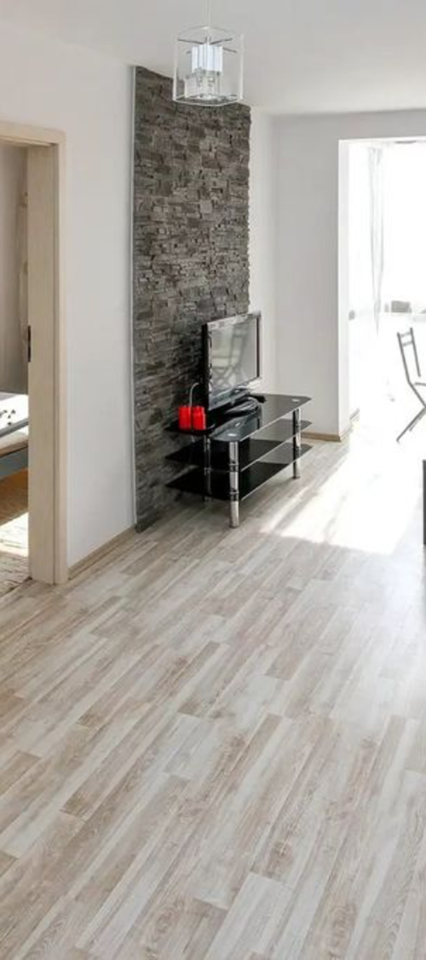
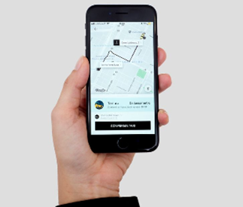
11. PEER – TO - PEER (P2P) (cont.)
Successful Examples
Airbnb Allows individuals to rent out their homes or properties to travelers, creating a decentralized hospitality marketplace.
Uber Connects riders with drivers for on-demand transportation services, leveraging a peer-to-peer model for ride-sharing.

Slide 27
12. FRANCHISE
The franchise business model is a system in which a business (the franchisor) grants the rights to use its brand, products, and operational model to an independent operator (the franchisee) in exchange for fees and royalties. This model allows for rapid expansion and brand consistency across different locations (Justis and Judd, 2004)
Franchisor Owns the overarching business concept, brand, and operational model.
Franchisee Invests in and operates a business unit using the franchisor's brand, systems, and support.
Franchise Fee
A one-time initial fee paid by the franchisee to the franchisor upon signing the franchise agreement.
Typically covers the right to use the franchisor’s brand name, business model, and initial support services.

Slide 28
12. FRANCHISE (cont.)
Franchisor Responsibilities
Support and Guidance
Training Providing initial and ongoing training programs to ensure franchisees understand and adhere to operational standards.
Operational Support Offering ongoing assistance in areas such as marketing, technology updates, and business management.
Brand Protection
Quality Control Implementing standards and procedures to maintain consistency in product or service quality across all franchise locations.
Compliance Monitoring franchisee adherence to brand guidelines, operational protocols, and legal requirements.

Slide 29
12. FRANCHISE (cont.)
Components and Management by Franchisor
Initial Franchise Fee
Purpose Compensates the franchisor for providing access to its established brand, business model, and support infrastructure.
Coverage Often includes training, initial marketing support, and assistance in site selection and setup.
Ongoing Fees
Royalties Regular payments made by franchisees to the franchisor, usually based on a percentage of sales or a flat fee.
Advertising Fees Contributions toward national or regional marketing efforts managed by the franchisor to benefit all franchisees.
Management and Allocation
Revenue Source Franchise fees contribute to the franchisor’s revenue stream, supporting ongoing operations, brand development, and support services for franchisees.
Legal and Compliance Franchisors manage the collection and allocation of fees in accordance with legal requirements and franchise agreements.

Slide 30
12. FRANCHISE (cont.)
Tech Franchises
While less common than in traditional sectors like food and retail, tech franchises do exist, particularly in areas like IT services, computer repair, and software training.
Tech franchises can benefit from leveraging established brand recognition, standardized processes, and centralized support in a rapidly evolving industry.
Big-Tech Case Studies
Apple Authorized Service Provider Apple authorizes third-party service providers to offer repair and support services for its products, operating under Apple’s guidelines and quality standards.
Microsoft Certified Partners Microsoft certifies IT service providers to offer solutions, consulting, and support for Microsoft products and technologies.

Slide 31
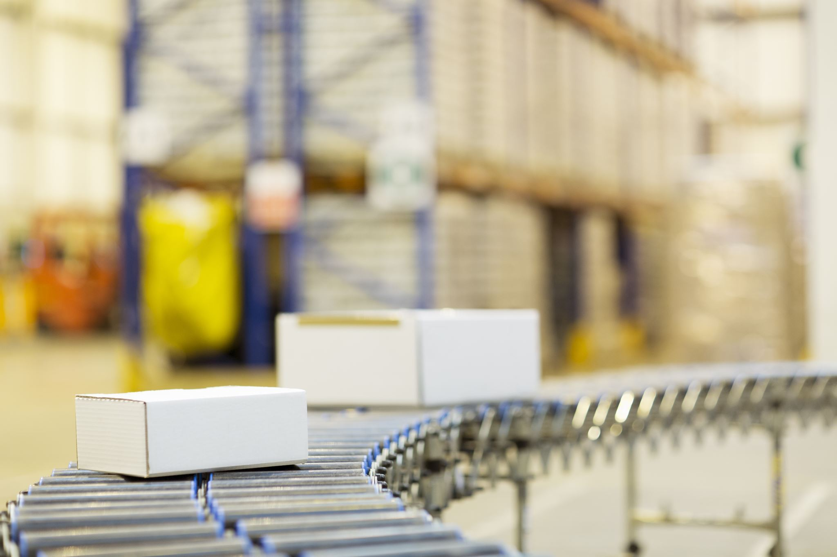
13. DROPSHIPPING
The Dropshipping business model is a retail fulfillment method where a store doesn't keep the products it sells in stock. Instead, when a store sells a product, it purchases the item from a third party and has it shipped directly to the customer. As a result, the seller doesn't handle the product directly. The main advantage of this model is that the store owner does not need to invest in inventory upfront (Greene, 2017)

Slide 32
13. DROPSHIPPING (cont.)
Operational Process
The retailer (Dropshipper) lists products on their online store without purchasing inventory upfront.
When a customer makes a purchase, the retailer forwards the order and shipment details to a supplier or wholesaler (dropship supplier).
The supplier then ships the product directly to the customer.

Slide 33
13. DROPSHIPPING (cont.)
Relevance in the Tech Industry
E-commerce Platforms
Dropshipping has gained popularity on major e-commerce platforms such as Shopify, WooCommerce, and eBay, enabling tech-savvy entrepreneurs to start online stores with minimal overhead.
Tech Integration
Automation tools and software streamline order processing, inventory management, and supplier communication, enhancing efficiency and scalability.
Digital marketing and SEO techniques are leveraged to attract customers and drive sales without traditional brick-and-mortar constraints.

Slide 34

13. DROPSHIPPING (cont.)
Case studies
Shopify
Shopify has facilitated numerous successful Dropshipping businesses through its e-commerce platform and integrated apps, offering entrepreneurs the tools to launch and manage online stores efficiently.
AliExpress
A prominent Dropshipping platform operated by Alibaba Group, connecting retailers with suppliers globally. It enables entrepreneurs to source a wide range of products directly from manufacturers or wholesalers.

Slide 35
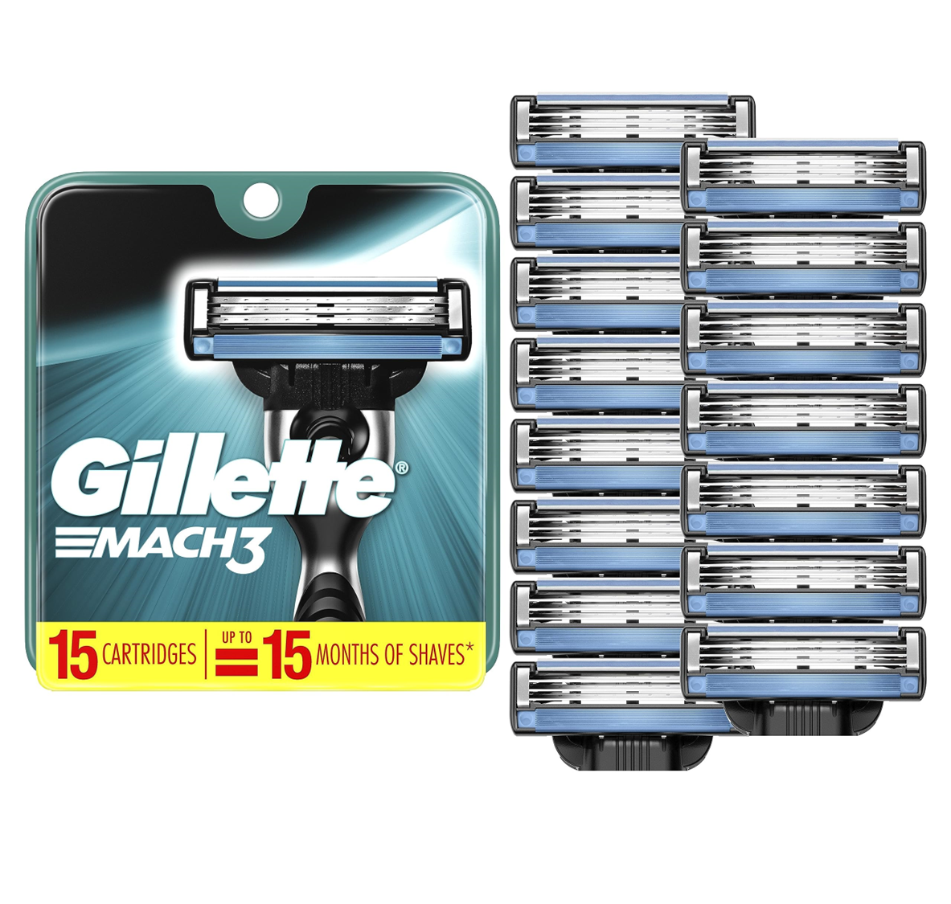
14. RAZOR AND BLADES
The Razor and Blades business model, also known as the "tied products model," involves selling a durable product at a low price (or giving it away for free) to increase sales of a complementary consumable product that generates recurring revenue.
The model gets its name from the classic example of selling razors at a low cost and making a profit from the ongoing sale of replacement blades (Shapiro and Varian, 1999).

Slide 36
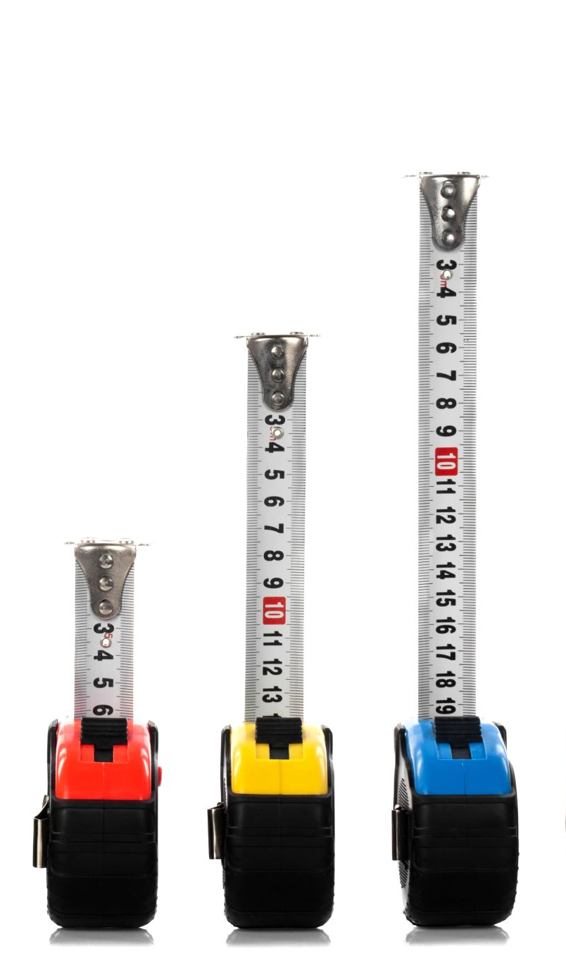
14. RAZOR AND BLADES (cont.)
Concept
Low-Cost Base Product The initial product (razor) is sold at a low price or even at a loss to attract customers.
High-Profit Consumables Complementary products or services (blades) are sold at a higher margin to generate recurring revenue.
Strategy
Lock-in Effect Customers are initially attracted by the low price of the base product and subsequently locked into purchasing higher-margin consumables over time.
Long-term Revenue Revenue is sustained through repeat purchases of consumables, creating a profitable lifecycle despite the initial low margins on the base product.

Slide 37

14. RAZOR AND BLADES (cont.)
Big Tech Case Study Gaming Consoles (e.g., Xbox and PlayStation)
Base Product (Razor) Game consoles are often sold at a subsidized or break-even price initially to attract gamers into their ecosystem.
Consumables (Blades) High-margin revenue is generated from game sales, downloadable content (DLC), subscriptions (e.g., Xbox Live, PlayStation Plus), and accessories.
Lock-in and Ecosystem Once consumers invest in a gaming console, they are more likely to purchase games and accessories specific to that platform, creating a profitable recurring revenue stream.

Slide 38
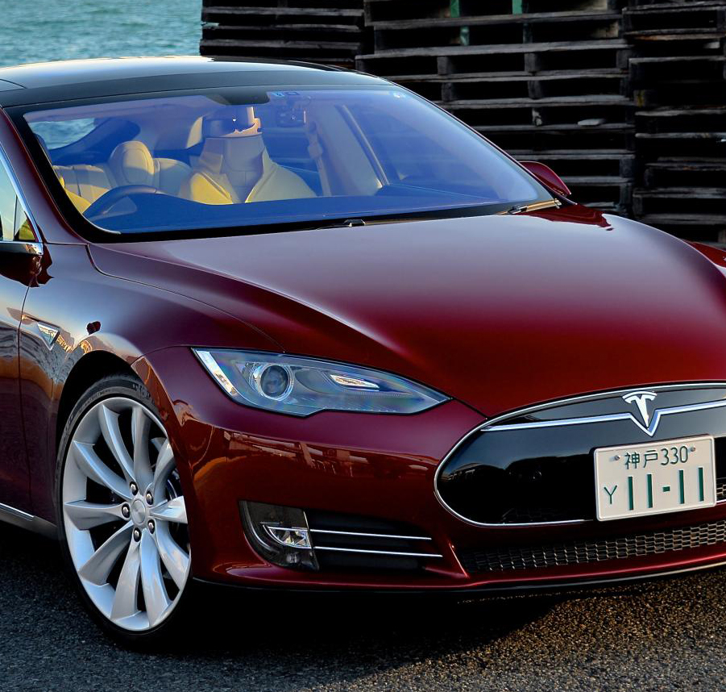
14. RAZOR AND BLADES (cont.)
Case study
Electric vehicles (EVs)
Tesla offers its electric vehicles (razor) and complements them with its Supercharger network and Tesla service centers (blades), generating ongoing revenue from service fees and potentially upgrades.
Air-Clean Machines
Companies like Dyson or Philips sell air purifiers (razor) and generate recurring revenue from replacement filters and maintenance services (blades), ensuring continued operation and efficiency of their products.

Slide 39
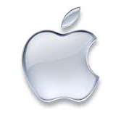
14. RAZOR AND BLADES (cont.)
Case study
Apple ecosystem
Apple leverages its ecosystem by selling premium hardware (razor) and generating recurring revenue from a variety of services and accessories (blades). This includes subscriptions to iCloud storage, Apple Arcade, and transactions through the App Store, ensuring ongoing engagement and revenue from its user base.

Slide 40

15. BUSINESS MODEL CANVAS (BMC)
The Business Model Canvas is a strategic management tool that allows entrepreneurs to describe, design, challenge, invent, and pivot their business model.
Created by Alexander Osterwalder and Yves Pigneur, it is a visual chart with elements describing a firm's or product's value proposition, infrastructure, customers, and finances.
It assists firms in aligning their activities by illustrating potential trade-offs (Osterwalder and Pigneur, 2010).

Slide 41
15. BUSINESS MODEL CANVAS (BMC)
Components 9 essential building blocks that cover the key aspects of a business, including:
Customer Segments
Value Propositions
Channels
Customer Relationships
Revenue streams
Key resources
Key activities
Key partnerships
Cost structure.

Slide 42

15. BUSINESS MODEL CANVAS (BMC)
"Every business model can be written on framework BMC".

Slide 43
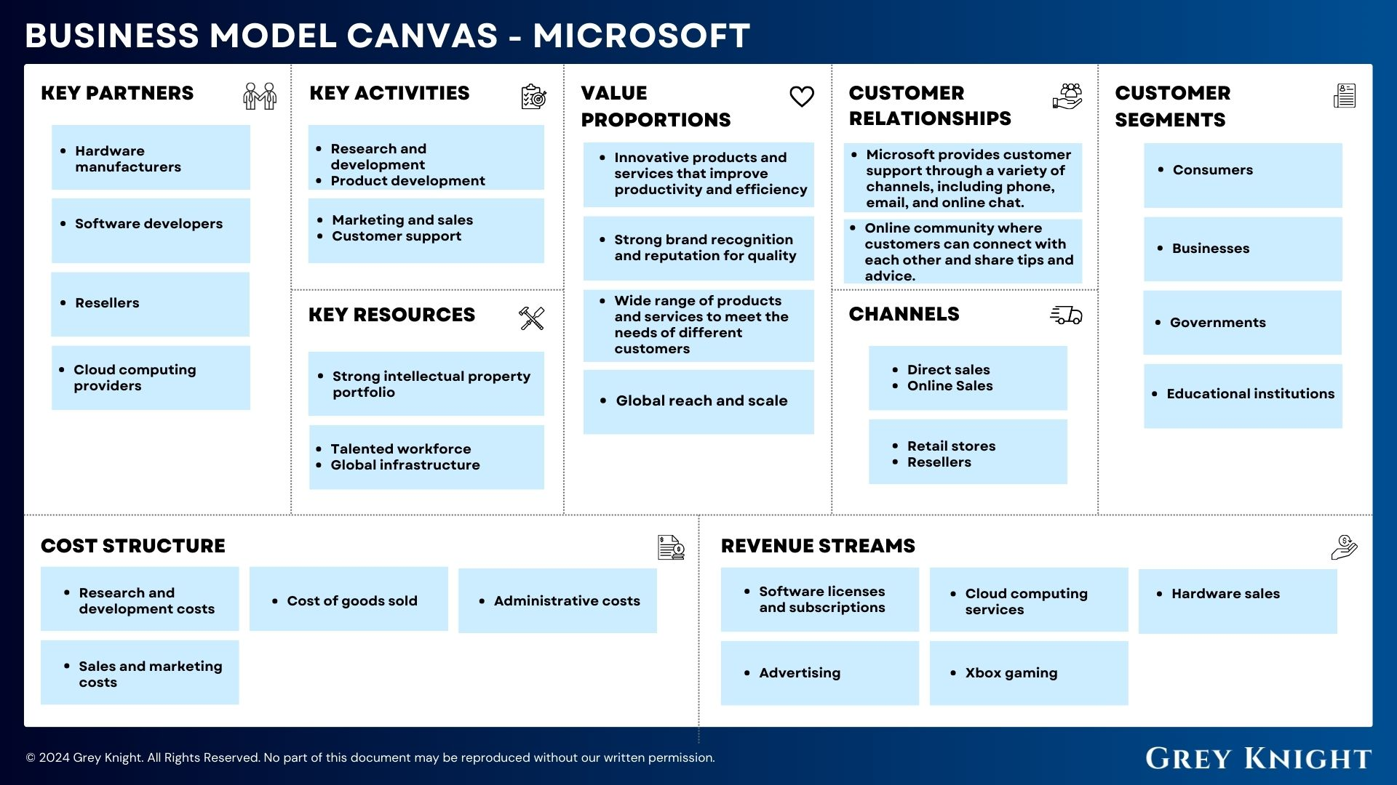
Example
https//greyknight.co.uk/microsofts-business-model-canvas/

Slide 44
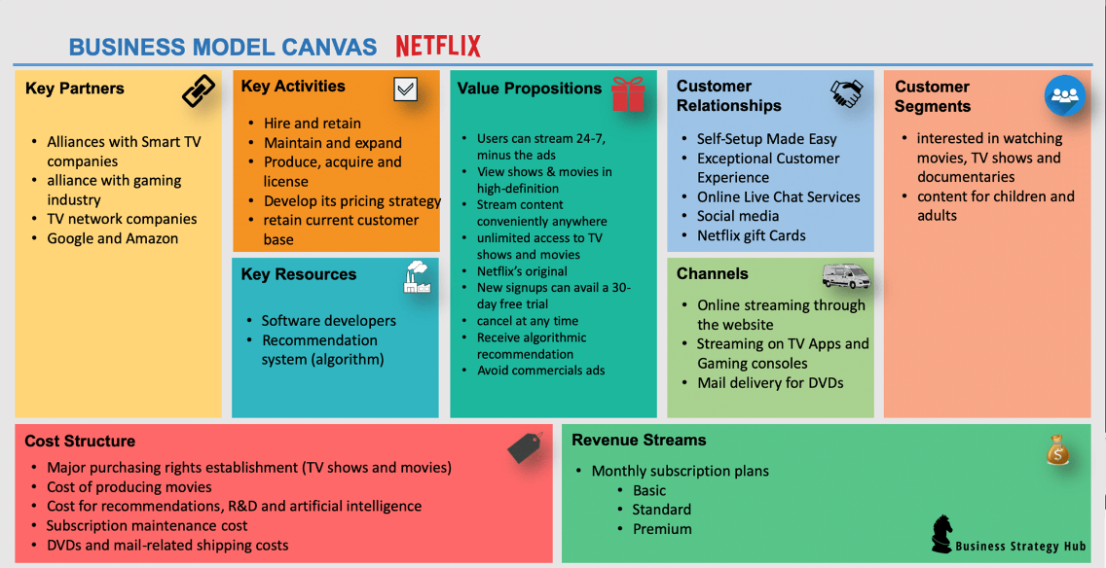
Example
https//bstrategyhub.com/netflix-business-model-how-does-netflix-make-money/

Slide 45
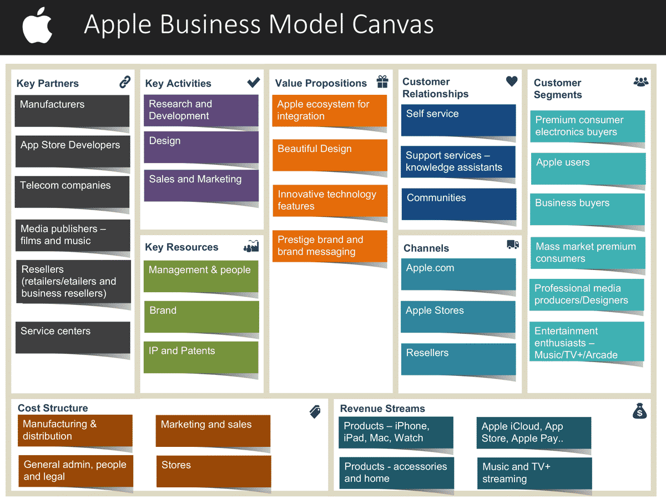
Example
https//www.garyfox.co/apple-business-model/

Slide 46

KEY TAKEAWAYS
Understand and Choose the Right Business Model
Focus on Scalability and Customer Value
Embrace Flexibility and Adaptability:

Slide 47
References
Amit, R. and Zott, C. (2001) ‘Value creation in e-business’, Strategic Management Journal, 22(6-7), pp. 493-520.
Botsman, R. and Rogers, R. (2010) What’s Mine Is Yours: The Rise of Collaborative Consumption. New York: HarperCollins.
Epstein, A. (2022) 'YC Guide to Business Models: YC Startup Library: Y combinator, YC Startup Library', Available at: https://www.ycombinator.com/library/Gh-yc-guide-to-business-models (Accessed: 07 July 2024).
Greene, C. L. (2017) Start Your Own Drop Shipping Business. 3rd edn. Irvine, CA: Entrepreneur Press.
Justis, R. T. and Judd, R. J. (2004) Franchising. 2nd edn. Ohio: Thomson Learning.
Magretta, J. (2002) ‘Why Business Models Matter’, Harvard Business Review, 80(5), pp. 86-92.
Osterwalder, A. and Pigneur, Y. (2010) Business Model Generation: A Handbook for Visionaries, Game Changers, and Challengers. Hoboken, NJ: Wiley.
Pujol, J. (2010) The Freemium Model: A Comprehensive Guide. London: Sage Publications.
Shapiro, C. and Varian, H. R. (1999) Information Rules: A Strategic Guide to the Network Economy. Boston: Harvard Business School Press.

Slide 48
The end.
Thank you for listening!

